Slide 1

Tablet Test Launch Findings

Slide 2
Summary
The positive response using tablets got off with a good start
Long waiting times is still a problem
Food ordering can be improved
Payment checkout is quick, some want cash
Birthday Club and Newsletter signups good

Slide 3
Overview
Measured food order delivery and accuracy
Counted tablet smooth operation
Analysed customer experiences with tablet usage
Collected waiting time at the lobby area
Measured checkout times for payment

Slide 4
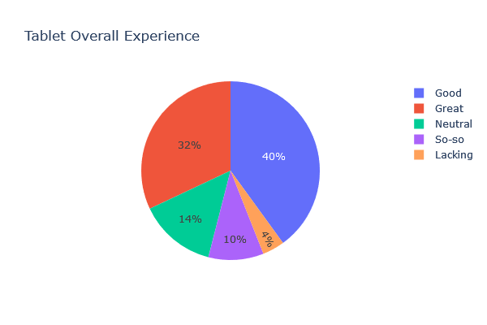
Findings

Slide 5
Next Steps
Improvement Needed
Lobby waiting times need to be reduced
Recommendation
Front and back staff teamwork to resolve it

Slide 6
Next Steps
Improvement Needed
Modes of payment: Card and cash
Recommendation
Menu option inside tablet for customers to choose

